Slide 1
Solar Energy

Slide 2
This energy comes from the Sun converting its mass into energy.
This might seem impossible but a famous scientist called Albert Einstein proved that it could happen.
You might know his formula E=mc² which shows that a small amount of mass can produce a huge amount of energy.

Slide 3

The Sun converts around 4 million tonnes of its mass to energy every day!
We don't need to worry about the Sun running out though. It has such a huge mass that it would take around 5 billion years to burn out.
This means that the Sun is considered to be a renewable energy source.

Slide 4
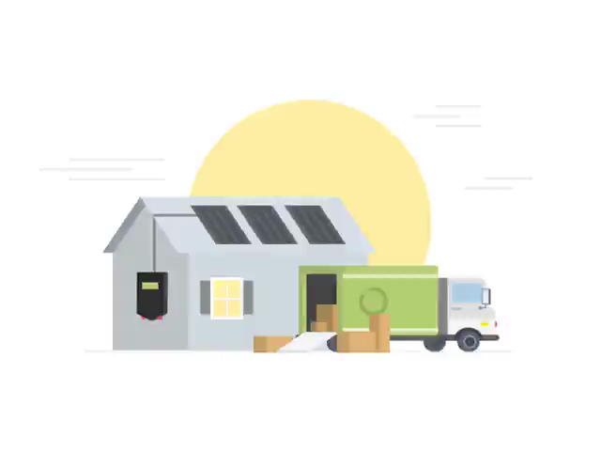
We can use solar energy to heat places and produce electricity.
The amount of solar energy which we can use depends on the amount of insolation. This is the amount of solar radiation which reaches the Earth.

Slide 5

There are three main factors which determine the amount of insolation:
The amount of solar energy which reaches the Earth.
The time it takes for the energy to be received.
The area the energy is spread over.

Slide 6
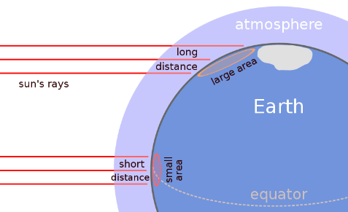
The area the solar energy is spread over depends on where you are.
The diagram below shows how solar energy is spread over a larger area at the poles than at the equator.
This means that the equator has a higher insolation than the poles.

Slide 7

Australia is a very large country. Places in the North like Darwin and Cairns are much closer to the equator than Southern cities like Hobart.
This means that Northern parts of Australia will have a higher insolation than Southern parts due to the angle of the Sun's rays.

Slide 8
There are three main ways which we use solar energy.
These are:
Solar thermal heating systems.
Passive solar heating systems.
Photovoltaic cells in solar panels.

Slide 9
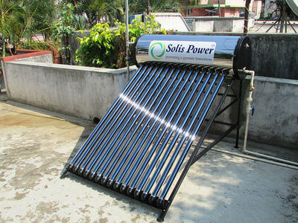
Solar thermal systems are used to convert solar energy into heat energy.
This is an active system because special equipment is used to collect and store the solar energy.
We use mirrors or lenses to collect solar energy for solar thermal systems. This heat is then transferred to where it is wanted.

Slide 10

Passive solar systems also convert solar energy into heat energy.
In these systems solar energy goes into a space - such as a room, car, or glasshouse - through a transparent material like glass. This heats the space.
No special equipment is needed for these systems. This means that they are passive.

Slide 11
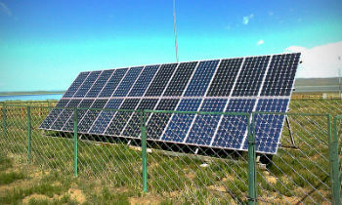
Unlike solar thermal and passive solar systems, photovoltaic cells convert solar energy into electrical energy.
Photovoltaic cells are located on solar panels. The electrical energy that they produce can either be used immediately or stored in batteries.

Slide 12
